Slide 1


RESUME EXTRACTION
By: Team ZeRoS
12-05-2021

Slide 2





TABLE OF CONTENTS
EXECUTIVE SUMMARY
01
PROBLEM STATEMENT
02
SAMPLE SIZE
03
EDA
04
RECOMMENDATIONS
05

Slide 3



EXECUTIVE SUMMARY
It is often observed by HR that the manual process of evaluation of Resumes in bulk which are populated with excess information often becomes tedious and hectic. Therefore, we could automate this process by reading several formats of files (CV). Then using some basic techniques of Natural Language Processing like word parsing, chunking, regex parser and/or Named Entity Recognition to easily capture information like name, email id, address, educational qualification, experience in seconds from a large number of documents.

Slide 4
PROBLEM STATEMENT
When companies recruit for any position, they usually end up receiving thousands, if not millions, of resumes. Such a large number of resumes makes the task of going over all these resumes an extremely difficult and tedious job for HR employees. This made a lot of companies opt for systems that take the necessary information from the candidate after they fill an application with all the required fields. The solution worked greatly for employers; nevertheless, candidates have always found it very illogical to spend tens of hours sharpening their CVs and cover letters only to find out that they must spend another hour or so re-entering all the information they have on their CVs in the designated fields.

Slide 5


SAMPLE SIZE
TYPE
VALUE
Total number of Observations 200
Total number of files 01
Total number of features 02
Base format of the file .txt
Dataset size 1.1 MB

Slide 6

EXPLORATORY DATA ANALYSIS

Slide 7
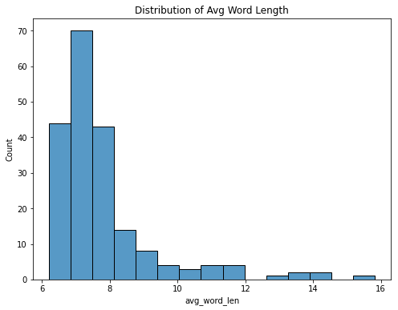

EDA
It is very clear that the average length of the word is 7 words.

Slide 8
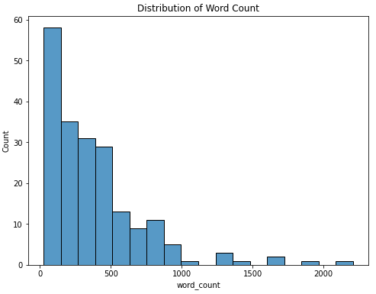
EDA
From the following graph it can be concluded that most of the Resumes contain less than 500 words.

Slide 9
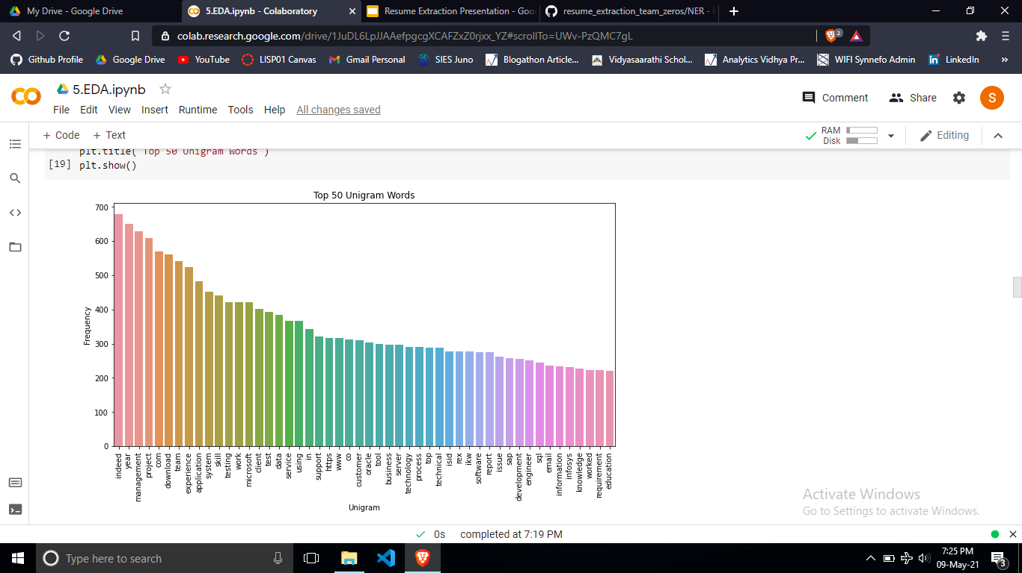
EDA
Top 3 frequent words are ‘Indeed’, ‘Year’ & ‘Management’.

Slide 10
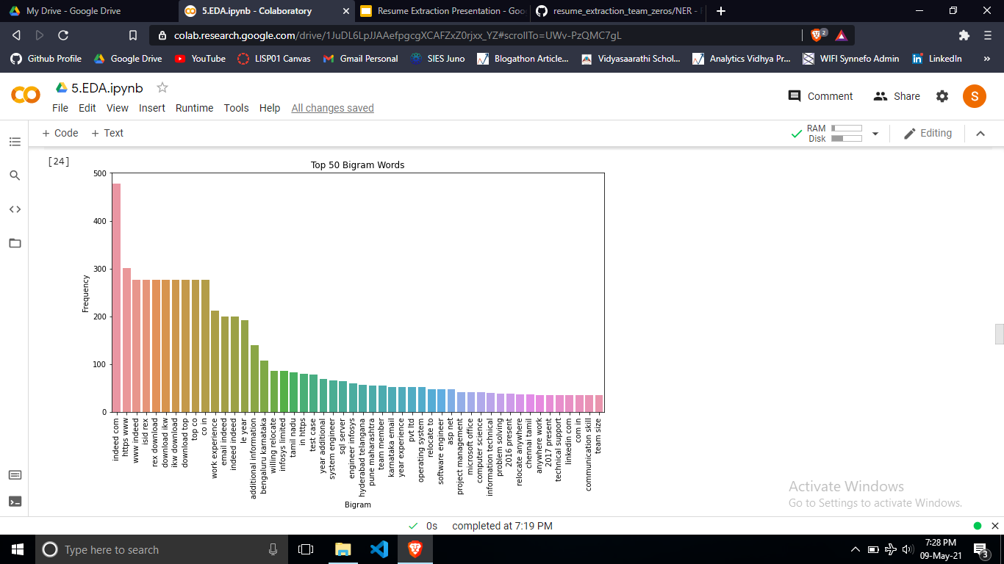
EDA
Top frequent words occurring in a pair are ‘Word experience’, ‘Email indeed’ & ‘Additional information’ that could be useful.

Slide 11
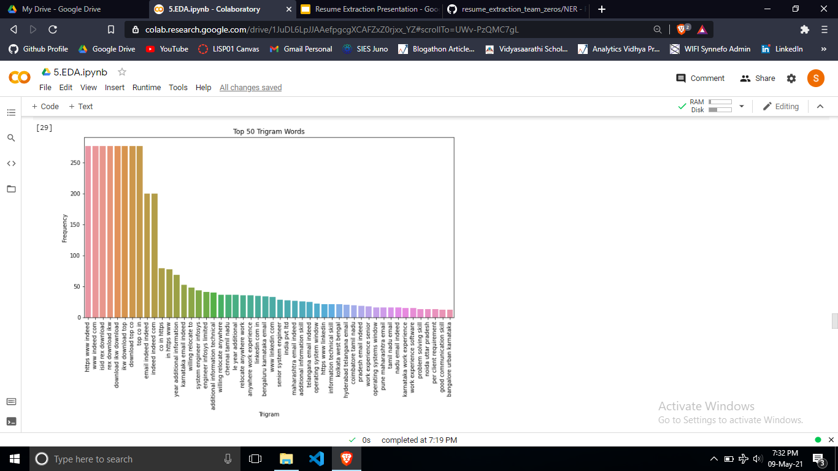
EDA
Top frequent 3 words occurring together are ‘Year additional information’, ‘Karnataka email indeed’ & ‘Willing relocate to’ that could be useful.

Slide 12
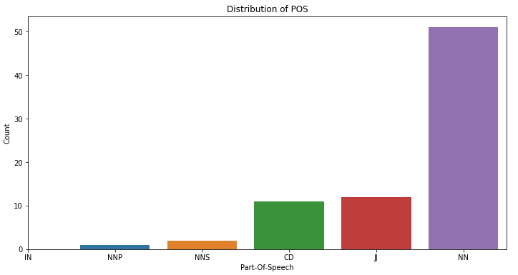
EDA
‘Singular noun’ is most commonly used, then comes ‘Adjective or numeral’, ‘Numeral (cardinal)’, ‘Proper plural noun’, ‘Singular proper noun’ and ‘Preposition or conjunction, subordinating’ respectively.

Slide 13
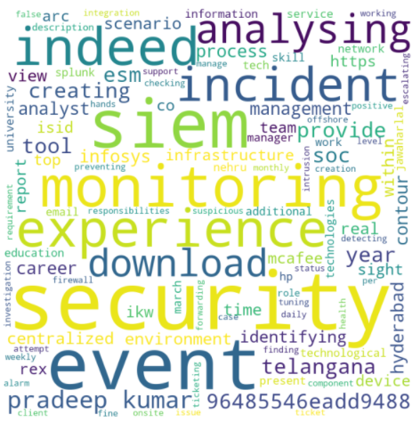
EDA
Graphical representations of word frequency. The larger the word in the visual the more common the word was in the resumes.

Slide 14
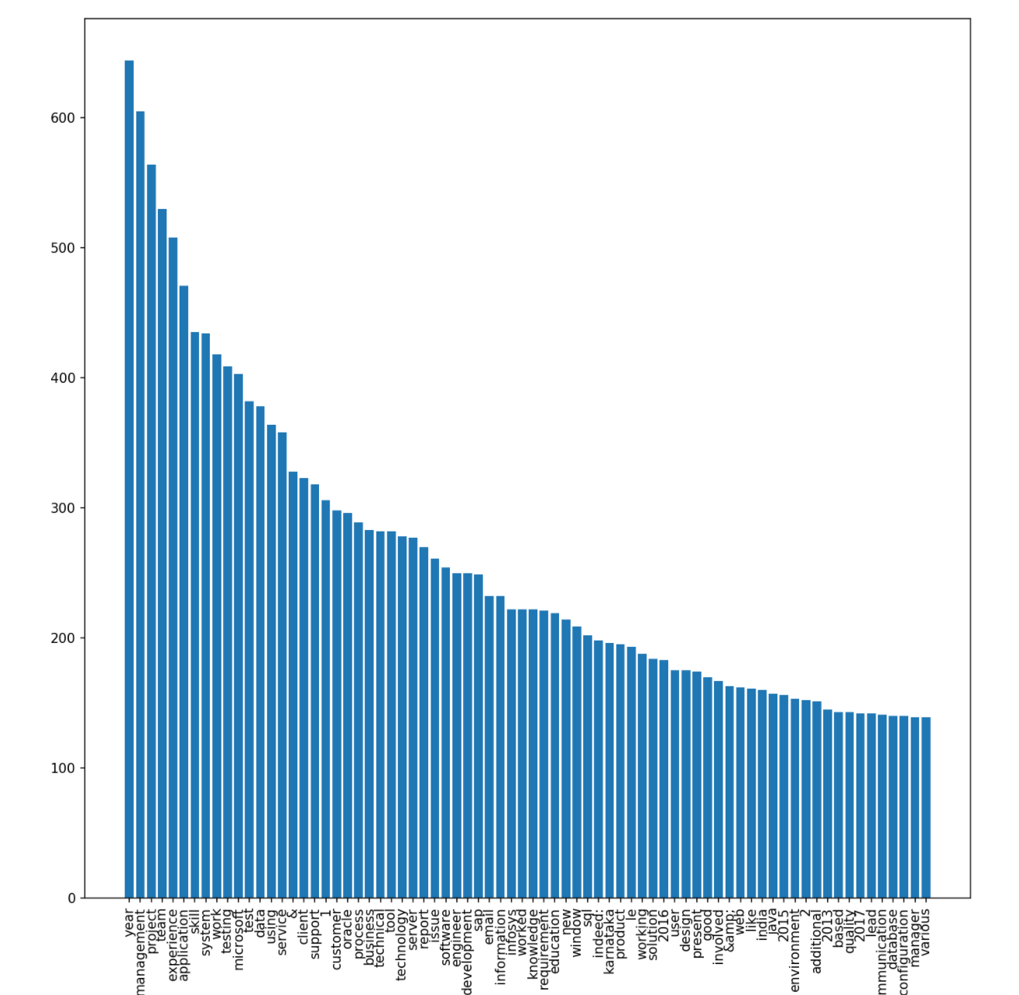
EDA
This bar graph
shows the frequency of
the 75 most-frequent in
all the resumes.

Slide 15
Insights from the Bar Graph
The most mentioned companies on the applicants resumes were Microsoft and Oracle.
Some of the keywords that the applicants emphasized on, in order, were management, data, testing, customer, business, technical and software.
Under the assumption that all the applicants are applying to the same vacancy, we can hypothesize that this job is a leadership role that requires business and customer-communication skills accompanied with technical skills.
The word “experience” was the 5th most frequent word, which demonstrates the high importance of experience over education in the job market.

Slide 16
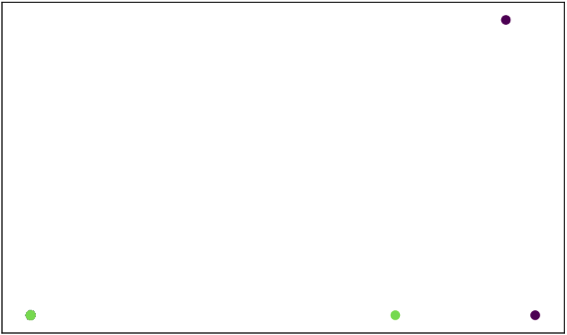
Attempting K-Means Clustering
When attempting to represe-
nt the 198 resumes using K-means
clustering, it is clear that the
graph fails to correctly cluster all
the points. The reason behind this
is the high number of dimensions
that each vector possesses since
we are using the Tf-Idf vectors to
the resumes.

Slide 17
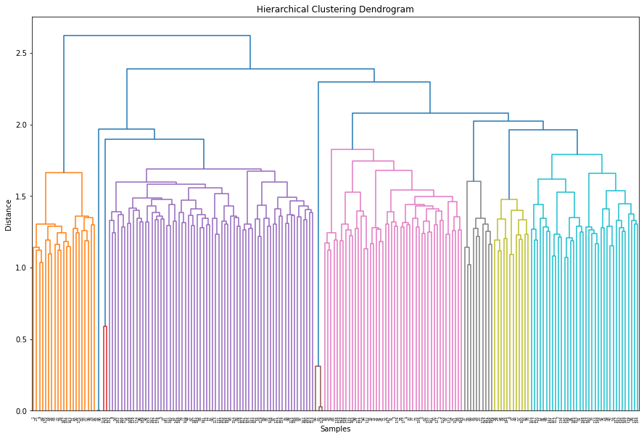
Hierarchical Clustering Analysis:
Hierarchical clustering groups
data over a variety of scales by
creating a cluster tree or
Dendrogram.
The tree is not a single set of
clusters, but rather a multilevel
hierarchy, where clusters at one
level are joined as clusters at
the next level.
Graphical Analysis:
The tree shows that we can split
our data into 8 clusters.
To identify each clusters which
group all features' values of
resumes we added colours to
each clusters.

Slide 18
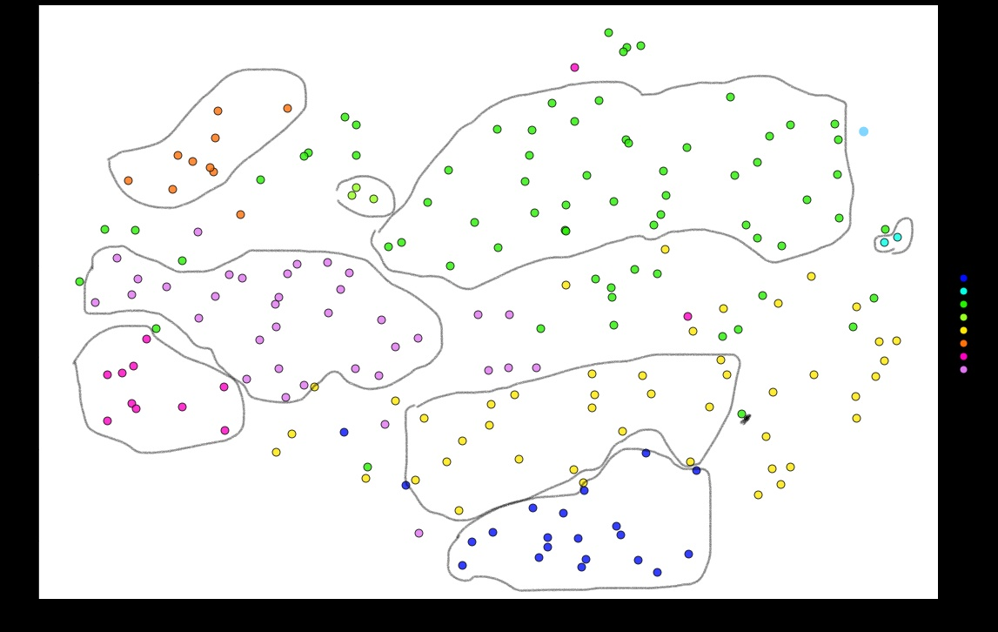
Taking 8 clusters, we visualize the texts, using UMAP along with Seaborn and Matplotlib. It allowed us to get projections in 2D.
We applied a method of how unstructured text data for a specific field, namely, recruiting can be organized. With the right feature engineering (TF-iDF transformation) it’s possible to split resumes into different groups (here we see 8 groups).

Slide 19
Model Recommendation and Selection
The model we selected is the SpaCy NER Model.
Through our analysis and search, we concluded that Linear models are not an option.
Due to time constrains, we were not able to delve deep into Deep Learning approaches that could have made of a great alternative for our case.
Additionally, other ensemble models such as Bagging and Bootstrapping were not serving our purpose.

Slide 20




THANK
YOU!

